Slide 1
Santander Product Recommendation
Team Members
Manasi Dalvi
Aaditya Bhat
Sweta Bajaj

Slide 2
Personal Goals
Goals
Professional Goals
✔ To predict which products their existing customers will use in the next month based on their past behavior and that of similar customers.
✔ To provide personalized product recommendations to customers.
To produce production ready, scalable system
Apply Functional Programming principles
✔ Learn Zeppelin and Spark
✔ Explore MLLib and Shark in Spark

Slide 3
Overview
PROCESS TOOL IMPLEMENTATION
Data Ingestion IntelliJ Functional Programming Principles
Data Cleaning Zeppelin Notebook Scala Functions, Spark SQL, RDD
Exploratory Data Analysis Zeppelin Notebook SparkSQL, Spark Visualizations
Model Fitting Zeppelin Notebook MLLib ,Dataframes

Slide 4
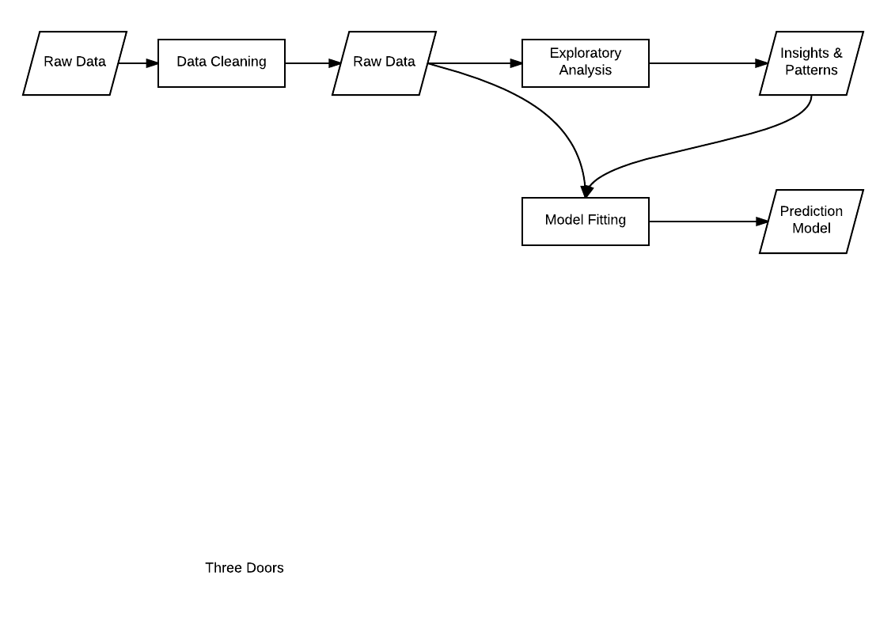
Data Pipe Line

Slide 5
Data Cleaning
Data Summary
Columns = 50
Rows = 13,647,309
Abnormalities = Many
Goal :
Handle Missing Values
Handle Abnormal Values
Handle Data Types

Slide 6
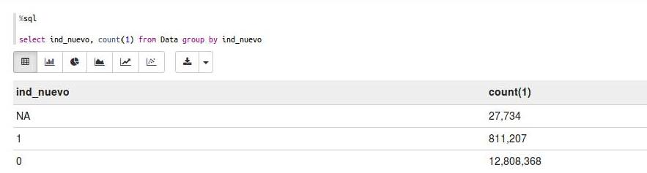
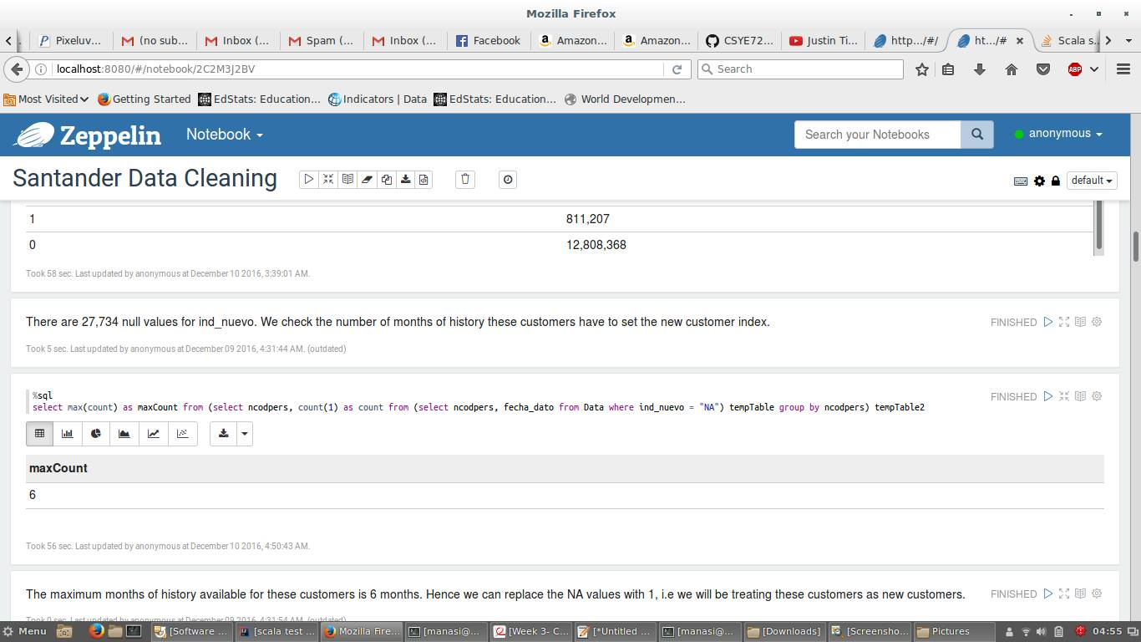
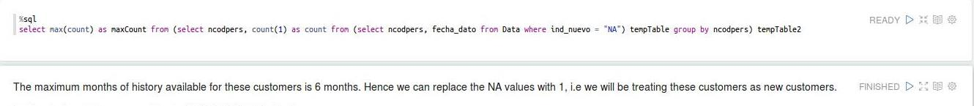
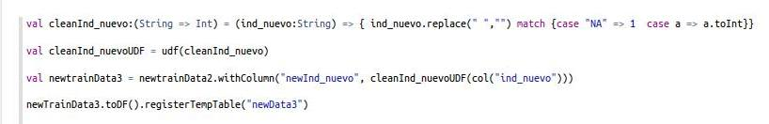
Data Cleaning Example

Slide 7
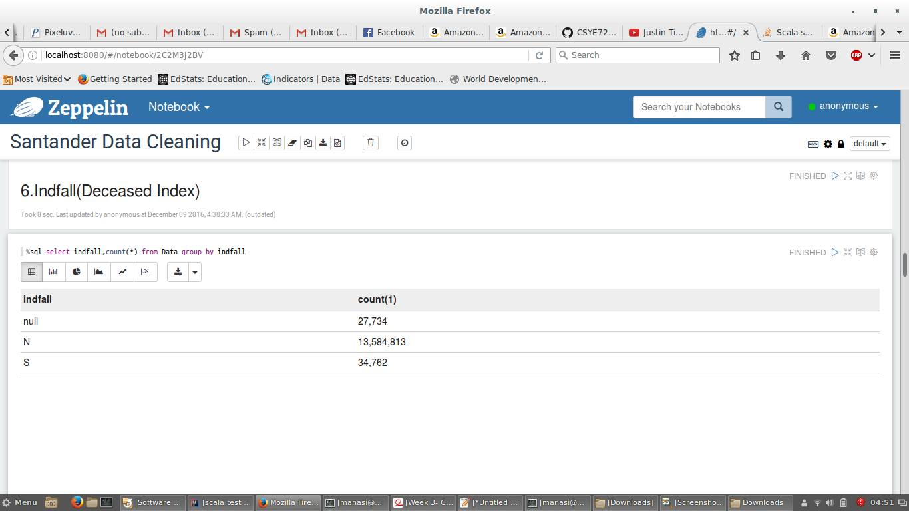
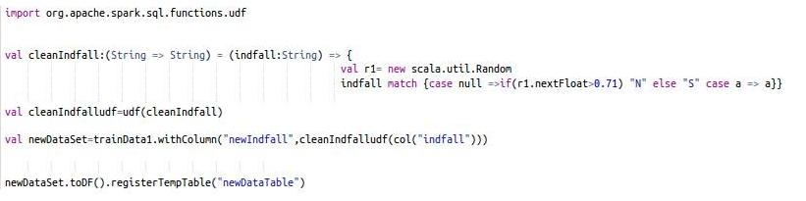
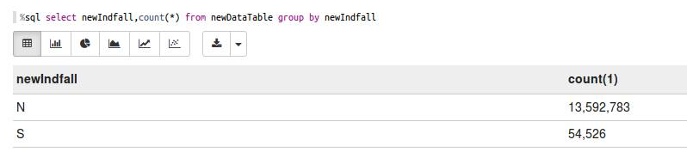
Data Cleaning Example 2

Slide 8
Data Cleaning Hurdles
Quantity of Data
Data Manipulations with Immutable Data Types
DataBricks Read CSV Library bugs
SQL output typecasting

Slide 9
Exploratory Analysis
Goal
To Understand Data
To Discover Various Patterns in the Data
To Leverage these Patterns in Model Building

Slide 10
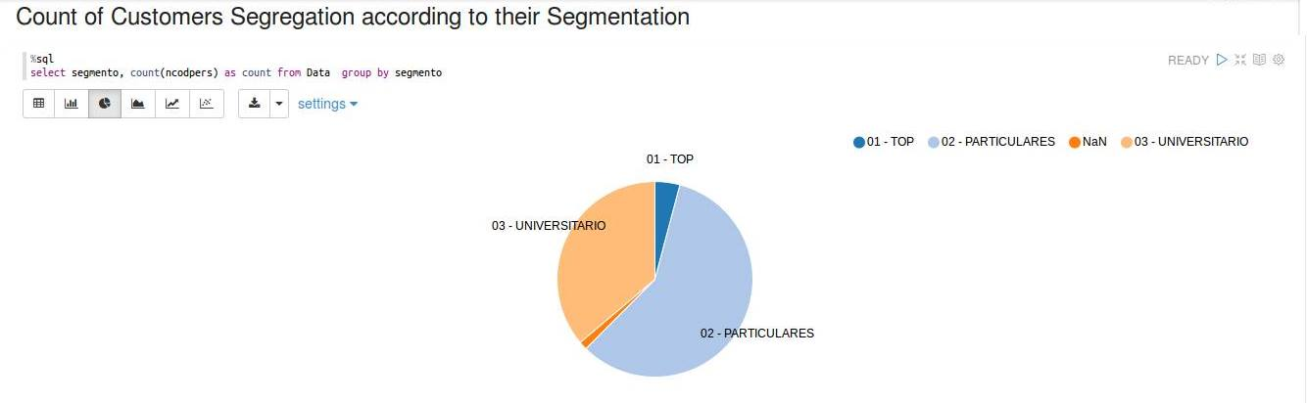
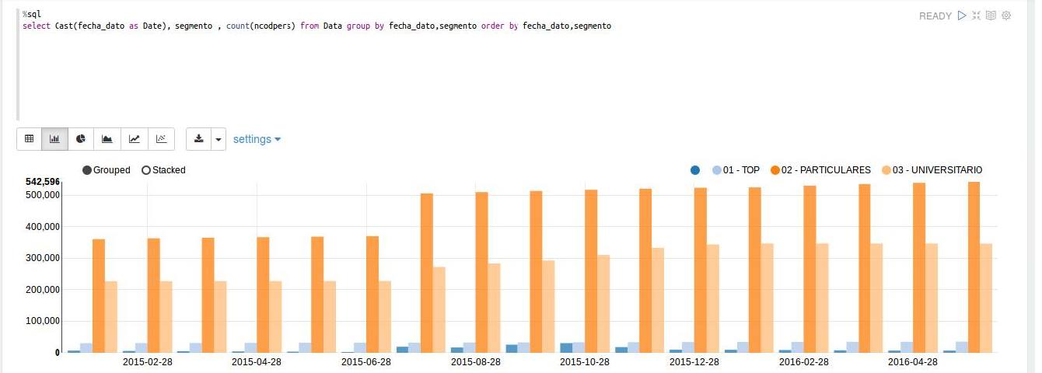
Exploratory Analysis Example

Slide 11
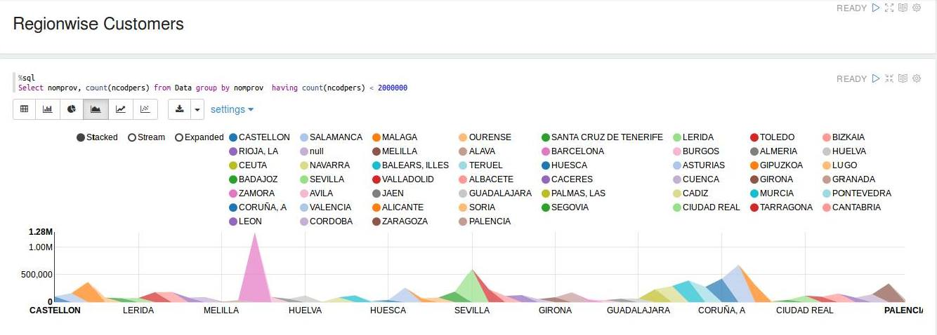
Exploratory Analysis Example

Slide 12
Exploratory Analysis Hurdles
Quantity of Data
SparkSQL Limitations
No subquery in Where clause
No standard SQL functions
Waiting for results on a large dataset

Slide 13
Model Fitting
To Find Efficient and Accurate Algorithm to make the predictions
Pattern recognition and processed the data logically to fit into the Model (Customers with new products monthly)
Used Random Forest from SparkMLlib on Dataframe API
Predicted Product Recommendations for Users

Slide 14
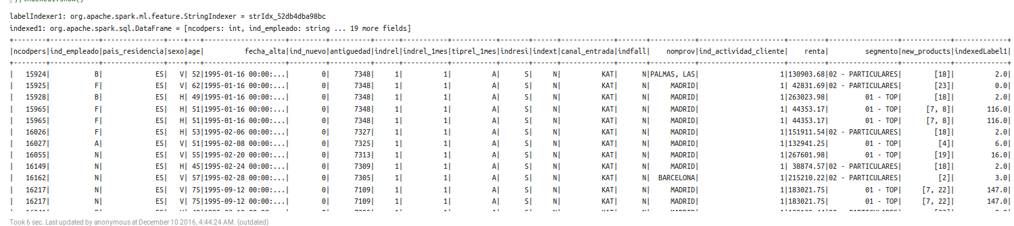
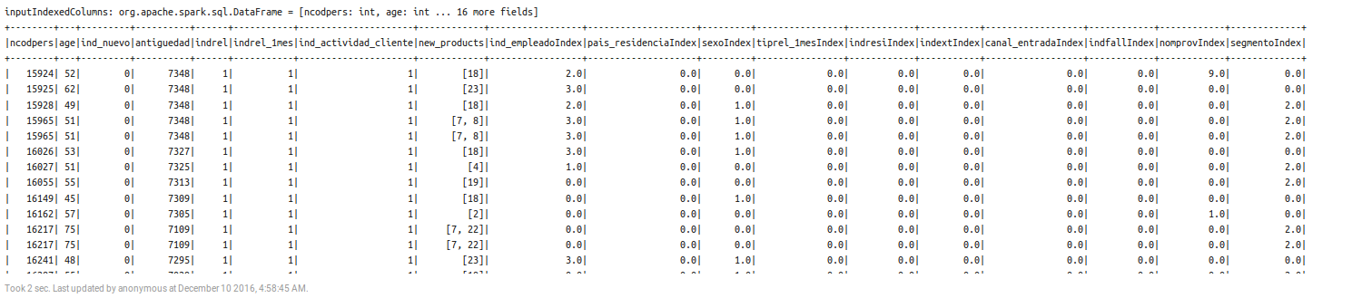
Model Fitting – Data Conversion

Slide 15
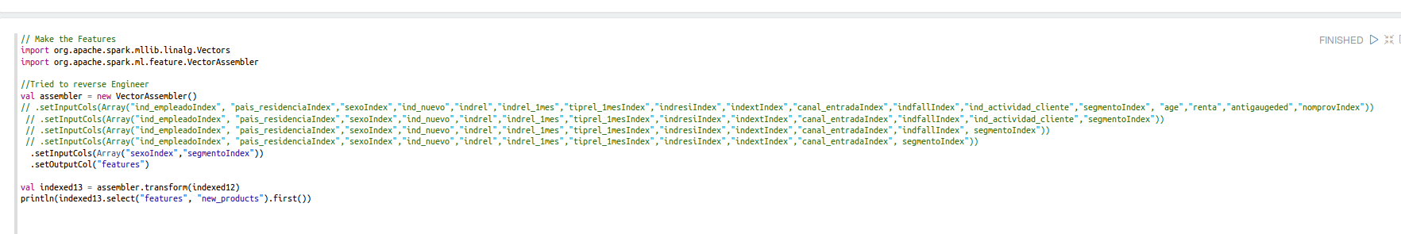
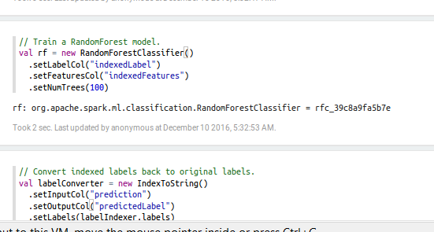
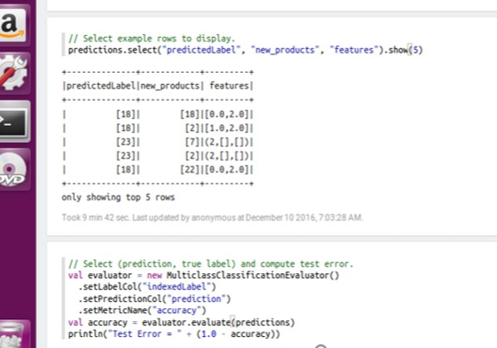
Model Fitting Example- Random Forest

Slide 16
Model Fitting Hurdles
Data Modelling Task – had to convert each feature categorically to build a Vector for the features
Had to partition large datasets in order to improve performance
Choosing the right Algorithm for the Data

Slide 17
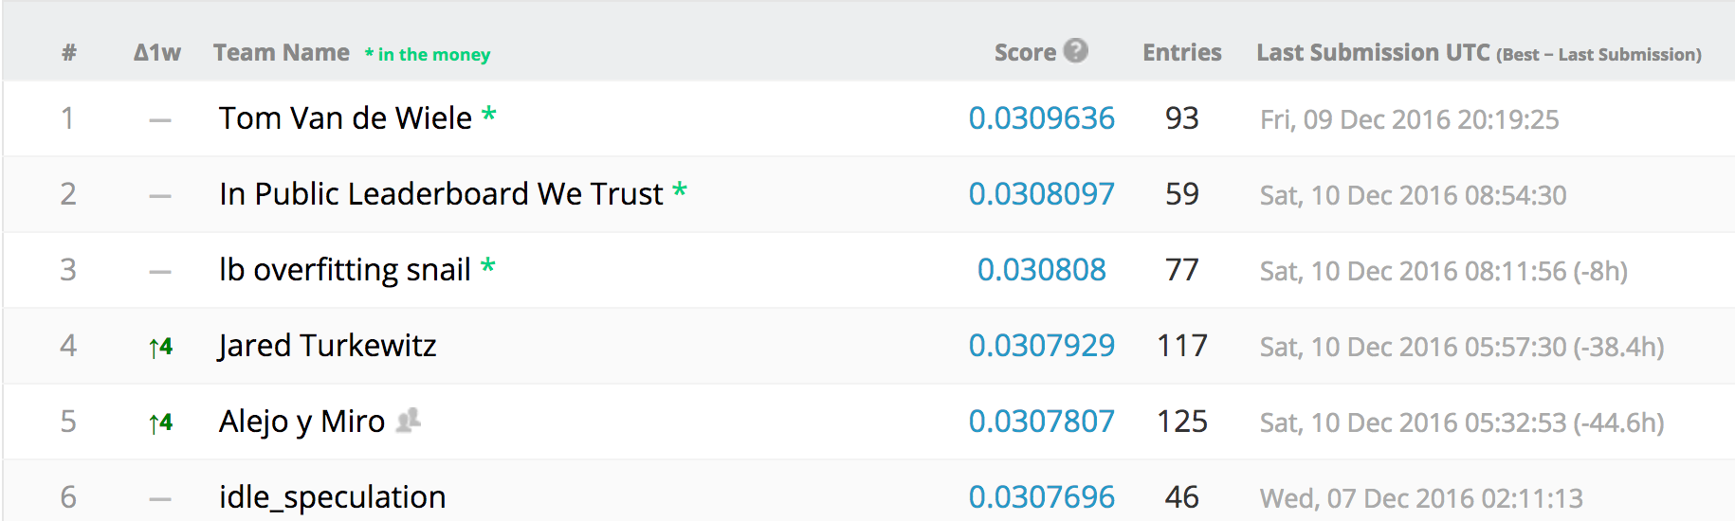
Acceptance Criteria
Mean Precision > 65% -- Not Achieved
Achieved Precision – 0.025729
Kaggle Leader Board

Slide 18
Thank you !

